Slide 1
Membangun Infrastruktur Berbasis Container Orchestration

Slide 2
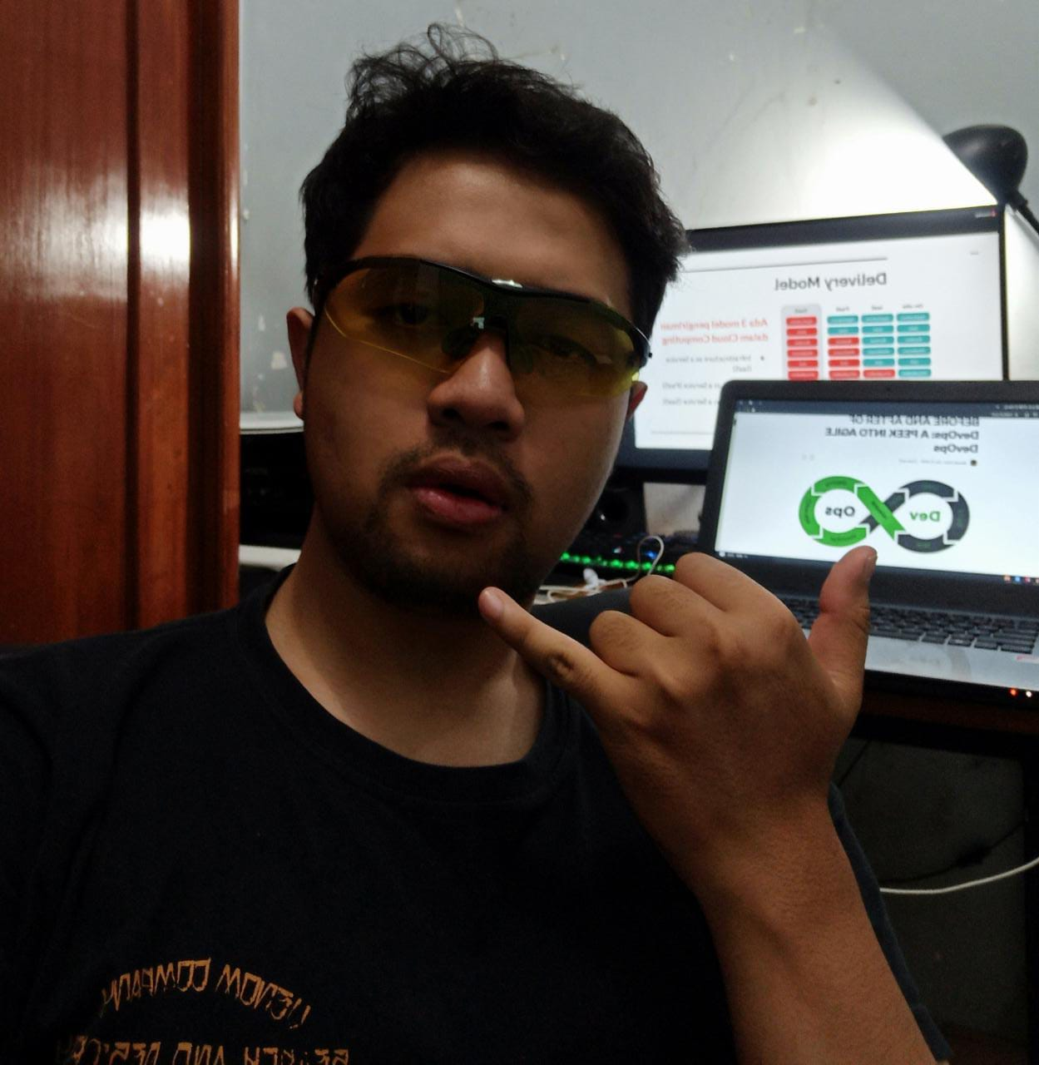
HELLO!
I am Hegi Septiyanto Wibowo
DevOps Engineer Specialist at Macross

Slide 3
Our Process
1
2
3
4
Merancang topologi untuk infrastuktur Container
Integrasi Cluster Container dengan layanan AWS Lainnya
Mengaplikasikan layanan Orchestration Kubernetes dan ECS
Melakukan migrasi dari non container menjadi container

Slide 4
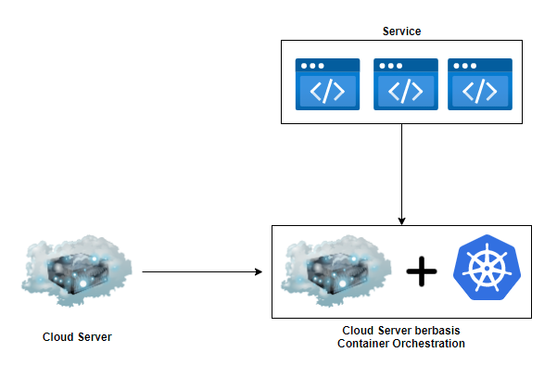
Introduction

Slide 5
Topologi Infrastruktur Cloud
1

Slide 6
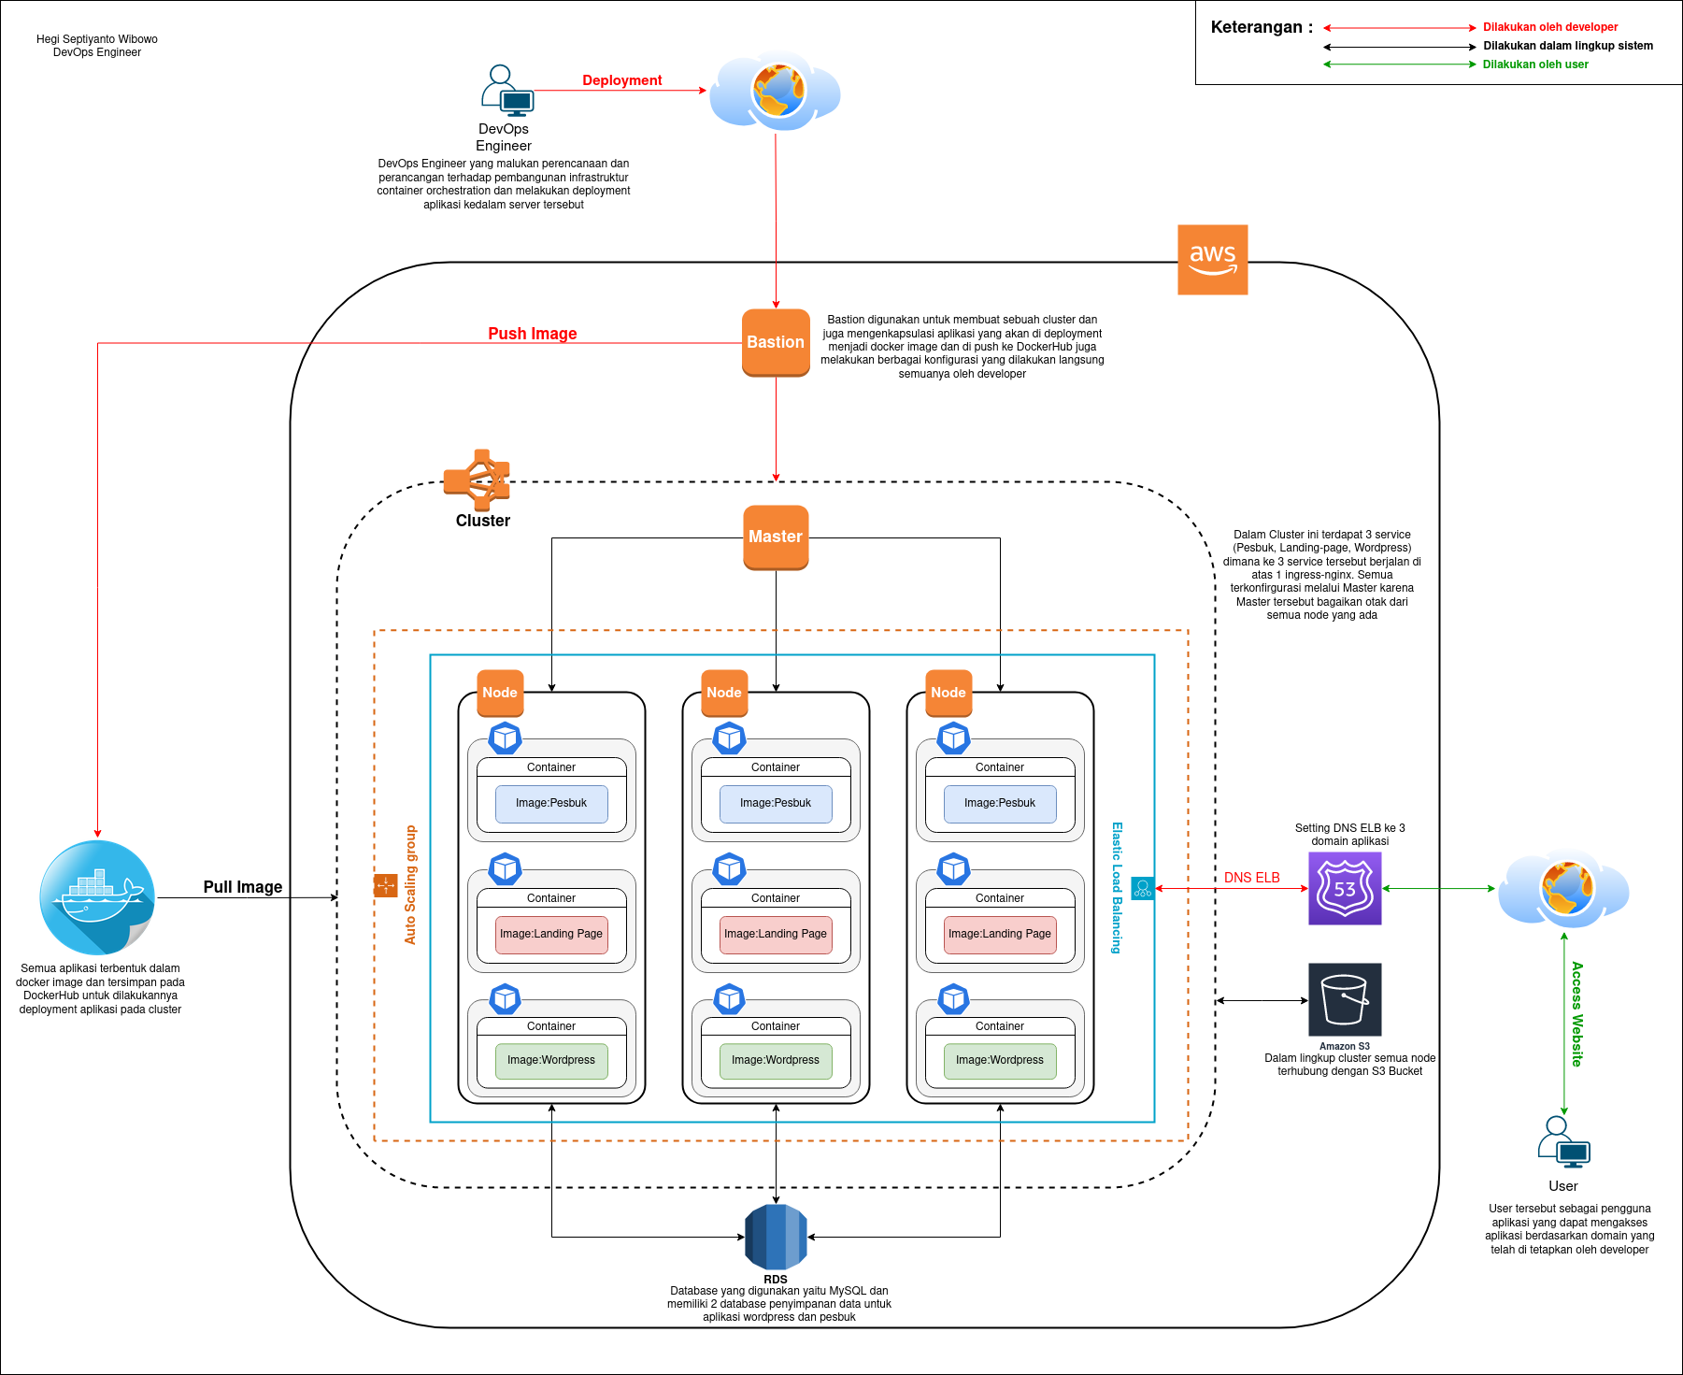

Slide 7
Budgeting Project
2

Slide 8
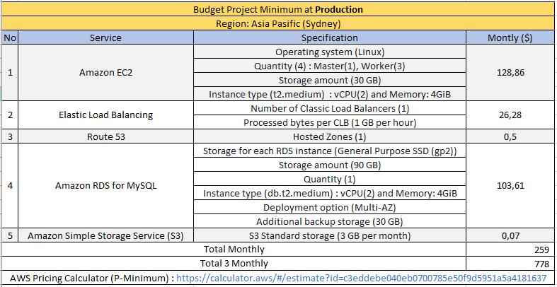
Budget for Production (Min)

Slide 9
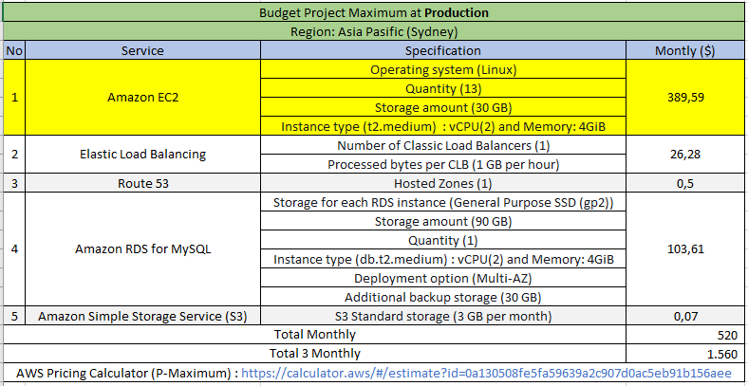
Budget for Production (Max)

Slide 10
Cluster For Project
3

Slide 11
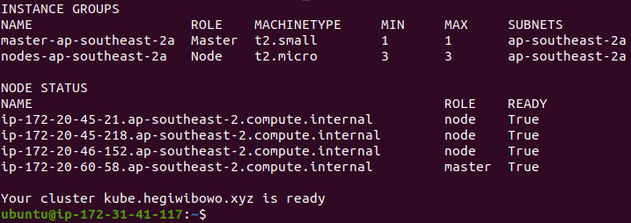
Create Cluster

Slide 12
Images Project
4

Slide 13
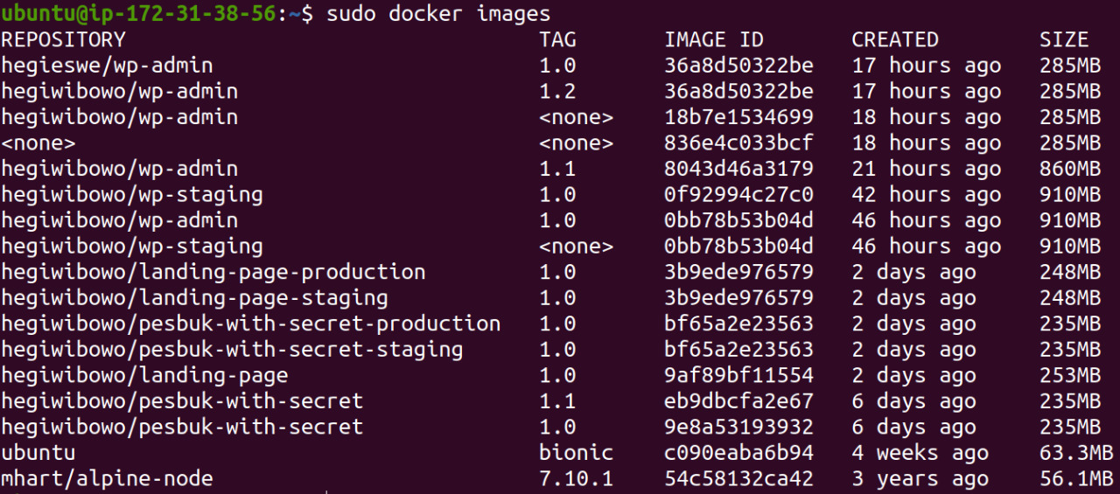
Create Images

Slide 14
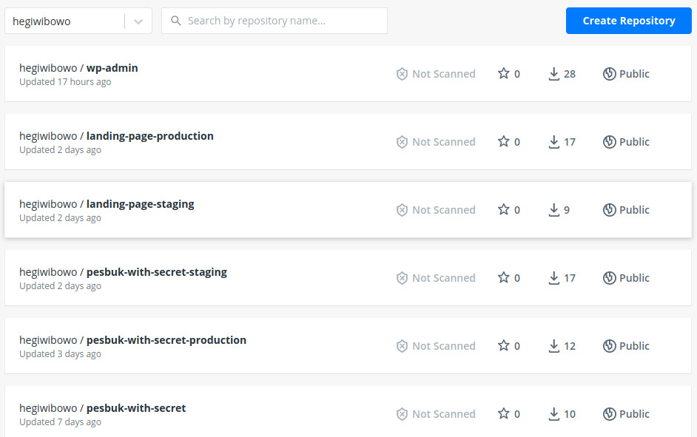
Push Image to Dockerhub

Slide 15
Deployment Project
5

Slide 16
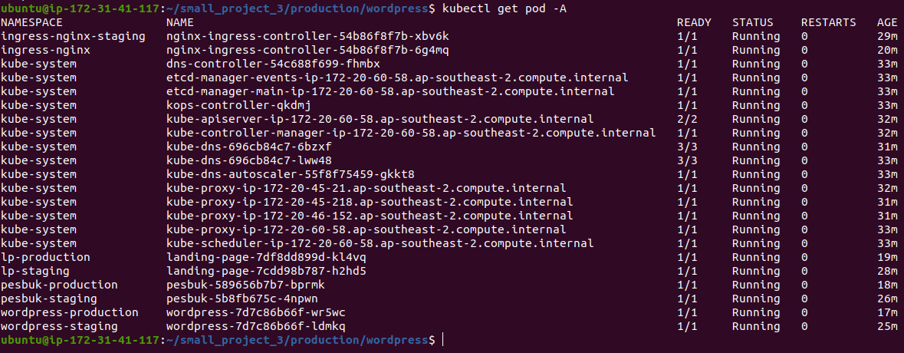
Pod and Ingress Project

Slide 17
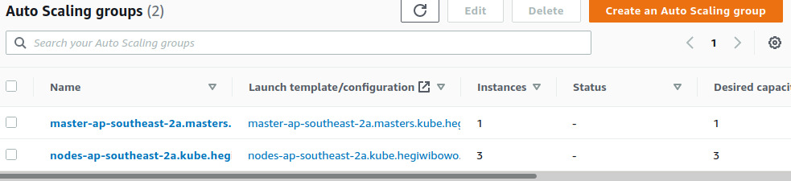
Auto Scaling

Slide 18

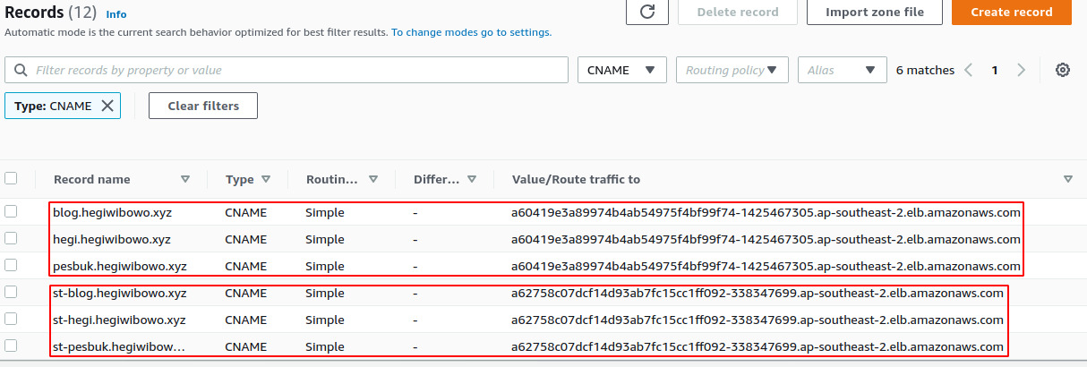
Route 53

Slide 19
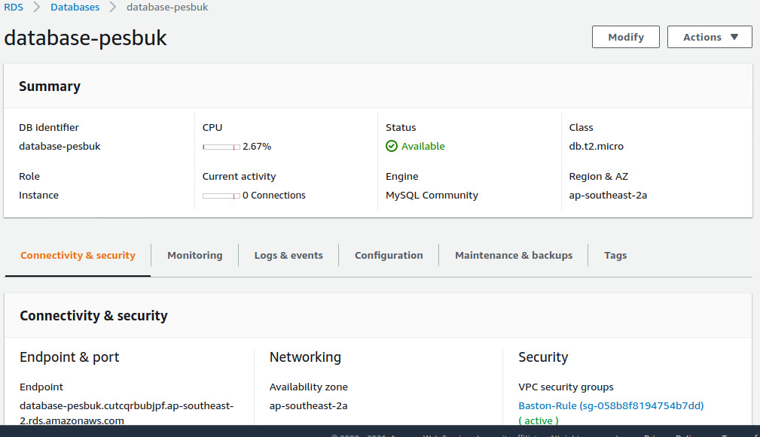
RDS Mysql

Slide 20
Ready To Release
7

Slide 21
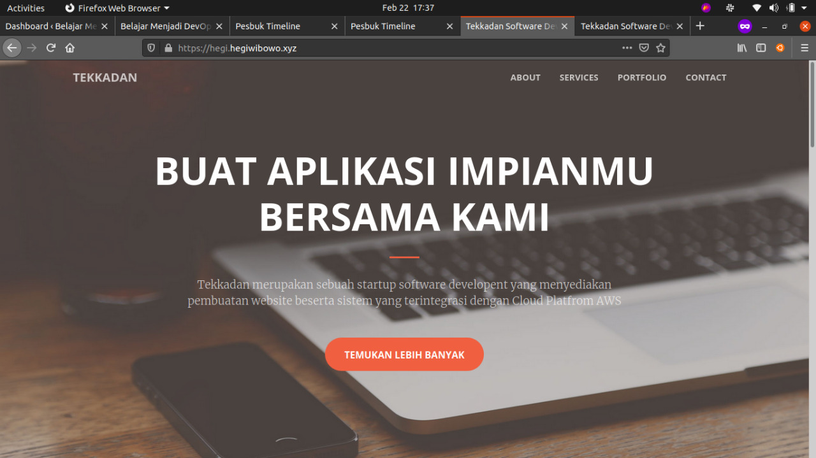
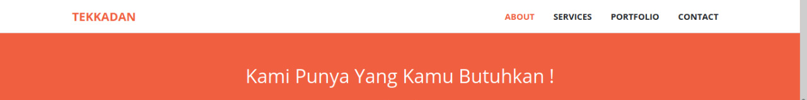

Slide 22

Demo Apps and Soucre Code

Slide 23
THANKS!
Any questions?
You can find me at:
Mobile Legend : Laki_Nub
Instagram : @hegi.eswe

